Slide 1
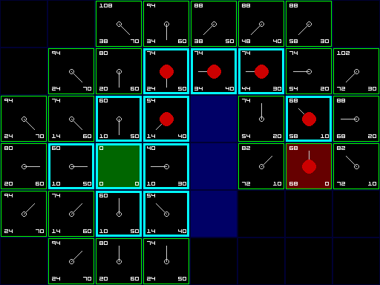
A* - Part I
Programming – AI for Games
Last modified 08/02/16 by Sam Cartwright

Slide 2
Contents
Dijkstra’s Algorithm Review.
What is a Heuristic?
What is A*?
F = G+H
Picking a Heuristic
A* Walkthrough

Slide 3
Dijkstra’s Algorithm Review
Dijkstra’s algorithm is a modification of BFS that finds the shortest path from a node to all other nodes in a graph.
It uses a priority queue to process the shortest distance node each time, therefore guaranteeing it traverses the shortest path.

Slide 4
What is a Heuristic?
A heuristic is a guess.
Sometimes, calculating a piece of information is computationally expensive. In these cases, there’s often another way to calculate the answer that is:
Not guaranteed to be correct, but
Is significantly faster.
We’re basically making an educated guess at the right answer without going to all the work to really figure it out.
We call these ‘guesses’ Heuristics.

Slide 5
What is a Heuristic?
Heuristics are used in many algorithms and in a lot of cases allow us to calculate a result that is almost as good as the real calculation (sometimes even the same) in a tiny fraction of the time.

Slide 6
What is A*?
A* (pronounced A-Star) is a heuristic algorithm.
A* is a modification of Dijkstra’s algorithm.
It can typically be implemented by only changing one or two lines of code.
It changes Dijkstra’s so that instead of picking the node that’s closest to the start to process each time, it picks the one that it thinks will get it closest to the goal.
The way A* figures out what node is closest is our heuristic

Slide 7
F = G + H
If you remember from Dijkstra’s, the G score is the cost to travel from the starting node to the node we are currently traversing.
For A* we add two new scores.
The H score is the heuristic, for each node we calculate how far away we think it is from the goal.
The F score – the final score for a node is the sum of the G and H scores

Slide 8
F = G + H
A* works exactly the same a Dijkstra’s except instead of running the priority queue off the G score, we run it off the F score.
You could even say the Dijkstra’s is just a special case of A* where the H cost is always 0.

Slide 9
Picking a Heuristic
The only thing left for us to implement A* is calculating the heuristic.
There are a number of common heuristics to use. For pathfinding, the two most common are:
Distance
just plain old distance. How far away, as the bird flies, is the current node from the goal.
Manhattan distance
For 2D this is the difference in the x plus the difference in the y. This typically leads to better paths for grid based graphs without diagonal movement.

Slide 10
Picking a Heuristic
A* isn’t just for movement, though.
There are many applications of graphs beyond pathfinding
Finding the shortest number of moves to win a board game.
For a board game, like chess, you could use the number of pieces caught as the heuristic.

Slide 11
Picking a Heuristic
One of the best things about A* is that we can easily modify how we calculate the heuristic as the game runs.
We can add in modifiers based on how many enemies are in a given area to make agents avoid it.
Or make distances to health pickups or powerups modify the heuristic score so that agents will naturally pick them up on their way to the goal node.

Slide 12

Picking a Heuristic
One of the best examples of this is Amnisia: The Dark Decent
The monster tries to path as close to the player as possible, but is actively avoiding being able to see the player.
This leads to many high tension sequences where the player hides under a table, or behind a box or in a cupboard with the monster walking past but avoids sequences where the player is repeatedly found which would be frustrating and pull the player out of the game.

Slide 13
A* Walkthrough
The algorithm for A* is once again, very similar to Dijkstra’s Algorithm.
Set all Ns to null, set all Gs to infinity
Push start node onto priority queue, set its N to itself and its G to 0
While queue not empty
Get the current node off the end of the queue and remove it.
Mark it as traversed
If the current node is the goal node, return.
Loop through its edges
If end node not traversed
Calculate current node’s F = Previous node’s G + the edge cost + heuristic of end node
If cost is less than existing F cost in end node
Set end node’s N to the current node
Set end node’s F to the current node’s G + the edge cost + heuristic of end node
If end node not in the queue
Push end node onto the queue

Slide 14
A* Walkthrough
N
G
2.32
N
G
Just like when we looked at Dijkstra’s, we’re going to travel from node 0 to node 4.
However, I’ve replaced all the line costs with their actual lengths.
0
1
3.69
1.65
3.9
N
G
2
1
N
G
N
G
2.32
5
3
1.5
G
N
1.4
4

Slide 15
A* Walkthrough
N
G
2.32
N
G
Priority Queue:
0
1
= untraversed
3.69
1.65
3.9
N
G
= traversed
2
1
N
G
N
G
2.32
5
3
1.5
G
N
1.4
4

Slide 16
A* Walkthrough
-
-
2.32
-
-
Priority Queue:
0
1
= untraversed
3.69
1.65
3.9
-
-
= traversed
2
1
-
-
-
-
2.32
5
3
1.5
-
-
1.4
4

Slide 17
A* Walkthrough
0
0
2.32
0
2.32
Priority Queue:
0
1
0
= untraversed
3.69
1.65
3.9
-
-
= traversed
2
1
0
3.9
-
-
2.32
5
3
1.5
-
-
1.4
4

Slide 18
A* Walkthrough
0
0
2.32
0
2.32
Priority Queue:
0
1
= untraversed
3.69
1.65
3.9
-
-
= traversed
2
1
0
3.9
-
-
2.32
5
3
1.5
-
-
1.4
4

Slide 19
A* Walkthrough
0
0
2.32
0
2.32
Priority Queue:
0
1
1
= untraversed
3.69
1.65
3.9
-
-
= traversed
2
1
0
3.9
-
-
2.32
5
3
1.5
-
-
1.4
4

Slide 20
A* Walkthrough
0
0
2.32
0
2.32
Priority Queue:
0
1
1
5
= untraversed
3.69
1.65
3.9
-
-
= traversed
2
1
0
3.9
-
-
2.32
5
3
1.5
-
-
1.4
4

Slide 21
A* Walkthrough
0
0
2.32
0
2.32
Priority Queue:
0
1
1
5
= untraversed
3.69
1.65
3.9
-
-
= traversed
2
So far, the algorithm has been identical to Dijkstra’s.
However, instead of picking the node with the smallest G score from the priority queue (Node 1), we pick the node with the lowest F score.
1
0
3.9
-
-
2.32
5
3
1.5
-
-
1.4
4
Notes:
Remembering the F score is G + H

Slide 22
A* Walkthrough
0
0
2.32
0
2.32
Priority Queue:
0
1
1
5
= untraversed
3.69
1.65
3.9
-
-
= traversed
2
F score for Node 1 = 2.32 + H
1
0
3.9
-
-
2.32
5
3
1.5
-
-
1.4
4

Slide 23
A* Walkthrough
0
0
2.32
0
2.32
Priority Queue:
0
1
1
5
= untraversed
3.69
1.65
3.9
-
-
= traversed
2
F score for Node 1 = 2.32 + H
H = 6.08
F = 2.32 + 6.08
F = 8.4
1
0
3.9
-
-
2.32
5
3
1.5
-
-
1.4
4

Slide 24
A* Walkthrough
0
0
2.32
0
2.32
Priority Queue:
0
1
1
5
= untraversed
3.69
1.65
3.9
-
-
= traversed
2
F score for Node 5 = 3.9 + H
H = 1.5
F = 3.9 + 1.5
F = 5.4
1
0
3.9
-
-
2.32
5
3
1.5
-
-
1.4
4

Slide 25
A* Walkthrough
0
0
2.32
0
2.32
Priority Queue:
0
1
1
5
= untraversed
3.69
1.65
3.9
-
-
= traversed
2
F score for Node 1 = 8.4
F score for Node 5 = 5.4
1
0
3.9
-
-
2.32
5
3
1.5
-
-
1.4
4

Slide 26
A* Walkthrough
0
0
2.32
0
2.32
Priority Queue:
0
1
1
5
= untraversed
3.69
1.65
3.9
-
-
= traversed
2
1
0
3.9
-
-
2.32
5
3
1.5
5
5.4
1.4
4

Slide 27
A* Walkthrough
0
0
2.32
0
2.32
Priority Queue:
0
1
1
= untraversed
3.69
1.65
3.9
-
-
= traversed
2
1
0
3.9
-
-
2.32
5
3
1.5
5
5.4
1.4
4

Slide 28
A* Walkthrough
0
0
2.32
0
2.32
Priority Queue:
0
1
1
4
= untraversed
3.69
1.65
3.9
-
-
= traversed
2
1
0
3.9
-
-
2.32
5
3
1.5
5
5.4
1.4
4
Notes:
On this slide you should ask the class to go though picking which node will be the next to be picked.
Node 1 will have the same F score as before – 8.4
Node 4 has the F score 5.4 (G + an H of 0)
So Node 4

Slide 29
A* Walkthrough
0
0
2.32
0
2.32
Priority Queue:
0
1
1
= untraversed
3.69
1.65
3.9
-
-
= traversed
2
1
0
3.9
-
-
2.32
5
3
1.5
5
5.4
1.4
4

Slide 30
A* Walkthrough
0
0
2.32
0
2.32
Priority Queue:
0
1
1
= untraversed
3.69
1.65
3.9
-
-
= traversed
2
Node 4 is the goal node so we exit.
1
0
3.9
-
-
2.32
5
3
1.5
5
5.4
1.4
4
Notes:
Remembering the F score is G + H

Slide 31
A* Walkthrough
In this example, note that the only nodes A* even looked at were the nodes for the final path.
The biggest advantage of A* over Dijkstra’s is that, given a good heuristic, it will run significantly faster.

Slide 32
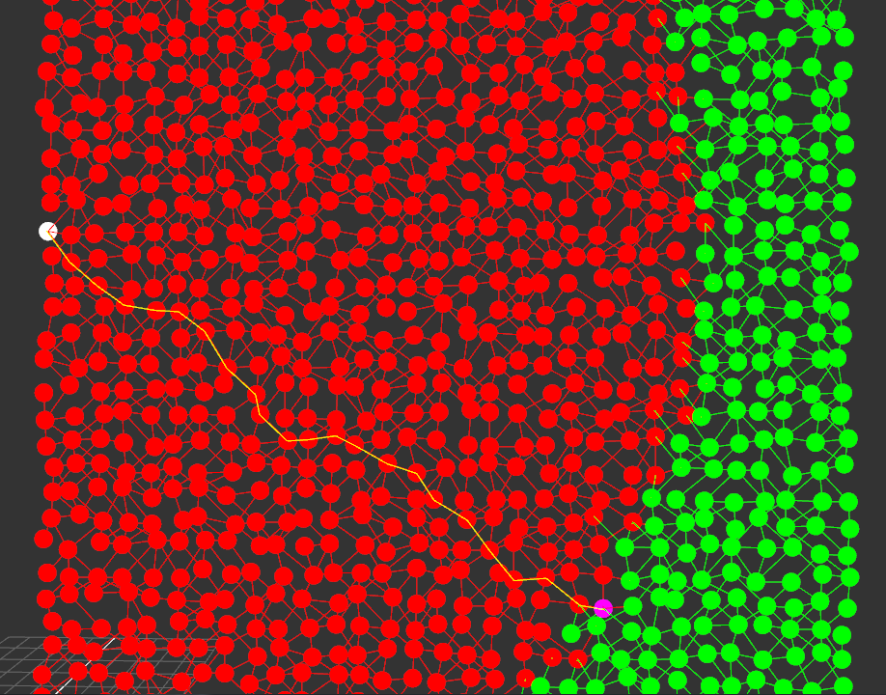
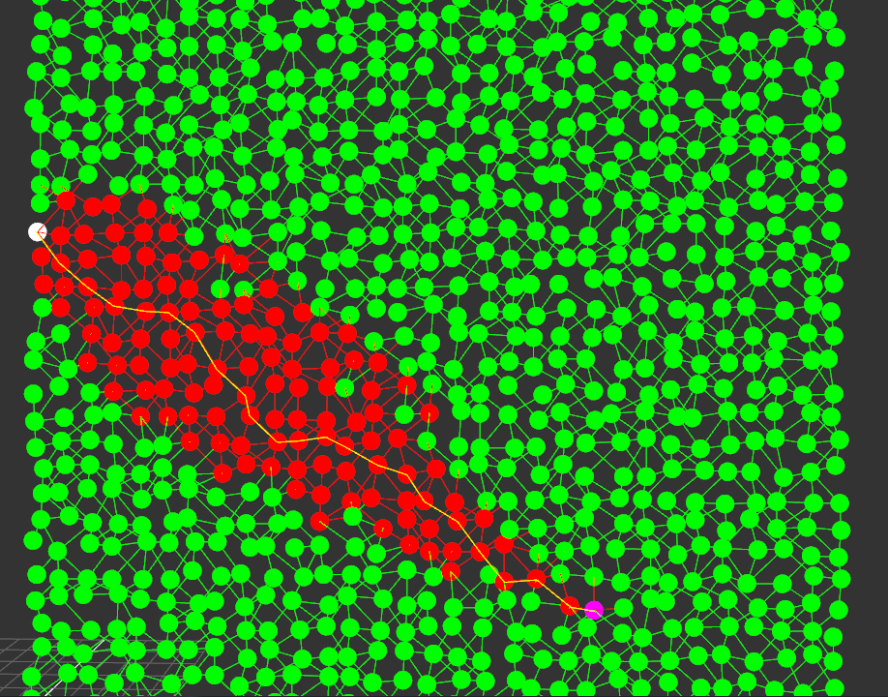
The Advantage of A*
Dijkstra’s
A*

Slide 33
Summary
AI pathfinding techniques are used to find the shortest path between two locations
Dijkstras is simple, and basically uses a ‘flood fill’ approach
It is not the most efficient algorithm
A Heuristic is a ‘best guess’ used when calculate an answer
The A* algorithm improves on Dijkstra’s by implementing heuristics
A* can be implemented differently by changing the heuristic used
A* is significantly faster than Dijkstra’s algorithm

Slide 34
References
Ian Millington, 2009. Artificial Intelligence for Games. 2 Edition. CRC Press.

